Slide 1



DAFNI Governance Board – 01/12/2020
Champion update
Juste Raimbault
CASA, UCL
Notes:
1

Slide 2
The MATSim (Multi-agent Transport Simulation) framework
Flexible open-source library for transport microsimulation:
Finest granularity (time, space, agents), scalable (country-level, millions of agents)
Multimodal (includes public transportation with schedules)
Activity-based (generalized adaptive scoring for agents daily plans)
Potential policy applications for the COVID crisis:
Impact of changes in commuting patterns on transportation
Indicators on physical contacts within transportation (basis of the EpiSIM epidemiological model)
Test of policies to limit these (flatten peak hour, higher level of service, alternative modes)
Notes:
2

Slide 3
Model exploration and sensitivity analysis
Model validation and application requires:
Coupling with a synthetic population generator (SPENSER model, already on DAFNI) and an ad-hoc activity generator
Heterogenous data integration: street network, public transportation networks and timetables, commuting flows
Calibration, exploration and sensitivity analysis (including spatial sensitivity analysis [Raimbault et al., 2019, JASSS, 22(4)] )
Integration within DAFNI:
High intra-model (high number of agents) and DOE computational burden
Numerical experiments and calibration with the OpenMOLE software [Reuillon et al., 2013, Fut. Gen. Comp. Sys., 29(8)]
Notes:
3

Slide 4
Current work update
Running on DAFNI
OpenMOLE embedding: sensitivity analysis, calibration
Road network preprocessing for MATSim on Functional Urban Areas
SPENSER model for synthetic population generation
Synthetic population preprocessing for MATSim on Functional Urban Areas
One-mode MATSim model coupled with road network and synthetic population processors
Current work:
SPENSER and MATSim visualisations
Four-stage model for travel demand
Future work:
Multimodal data processing and MATSim model
Health indicators downstream MATSim
Sensitivity analysis, calibration and validation using OpenMOLE
Notes:
4

Slide 5
OpenMOLE model exploration software
Aim: to provide OpenMOLE methods (Design of Experiments, Sensitivity Analysis, Genetic Algorithm Calibration, Diversity Search, Spatial Sensitivity Analysis) to DAFNI users
Running workflow with OpenMOLE + visualization (dummy example of a Saltelli Global Sensitivity Analysis)
Need to embed model inside the OpenMOLE docker with experiment scripts
No interactive access to workflow system (future possibility as a visualization step?)
Running workflow with a NSGA2 calibration for a real model (urban network model – see https://arxiv.org/abs/2009.05528)
Notes:
5

Slide 6
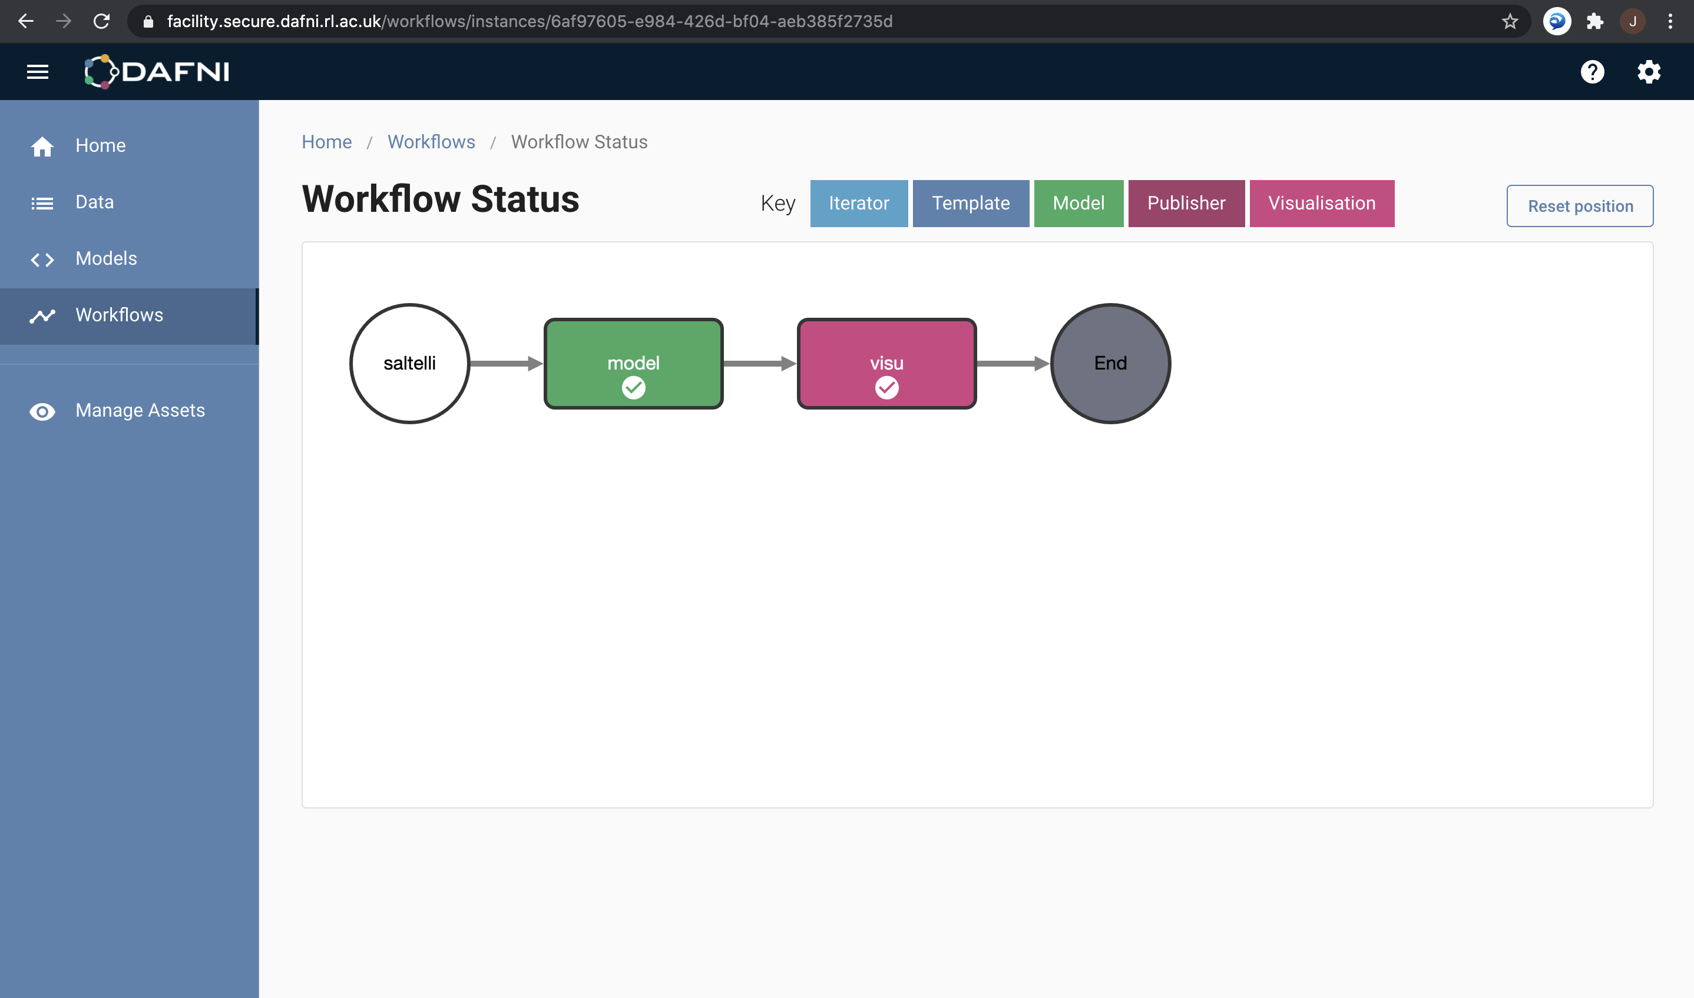

Embedding OpenMOLE experiments in DAFNI
Visualization in R
Docker image
Model code - tested: JVM
- R, python, C, etc.
Experiment
Script (.oms)
Notes:
6

Slide 7
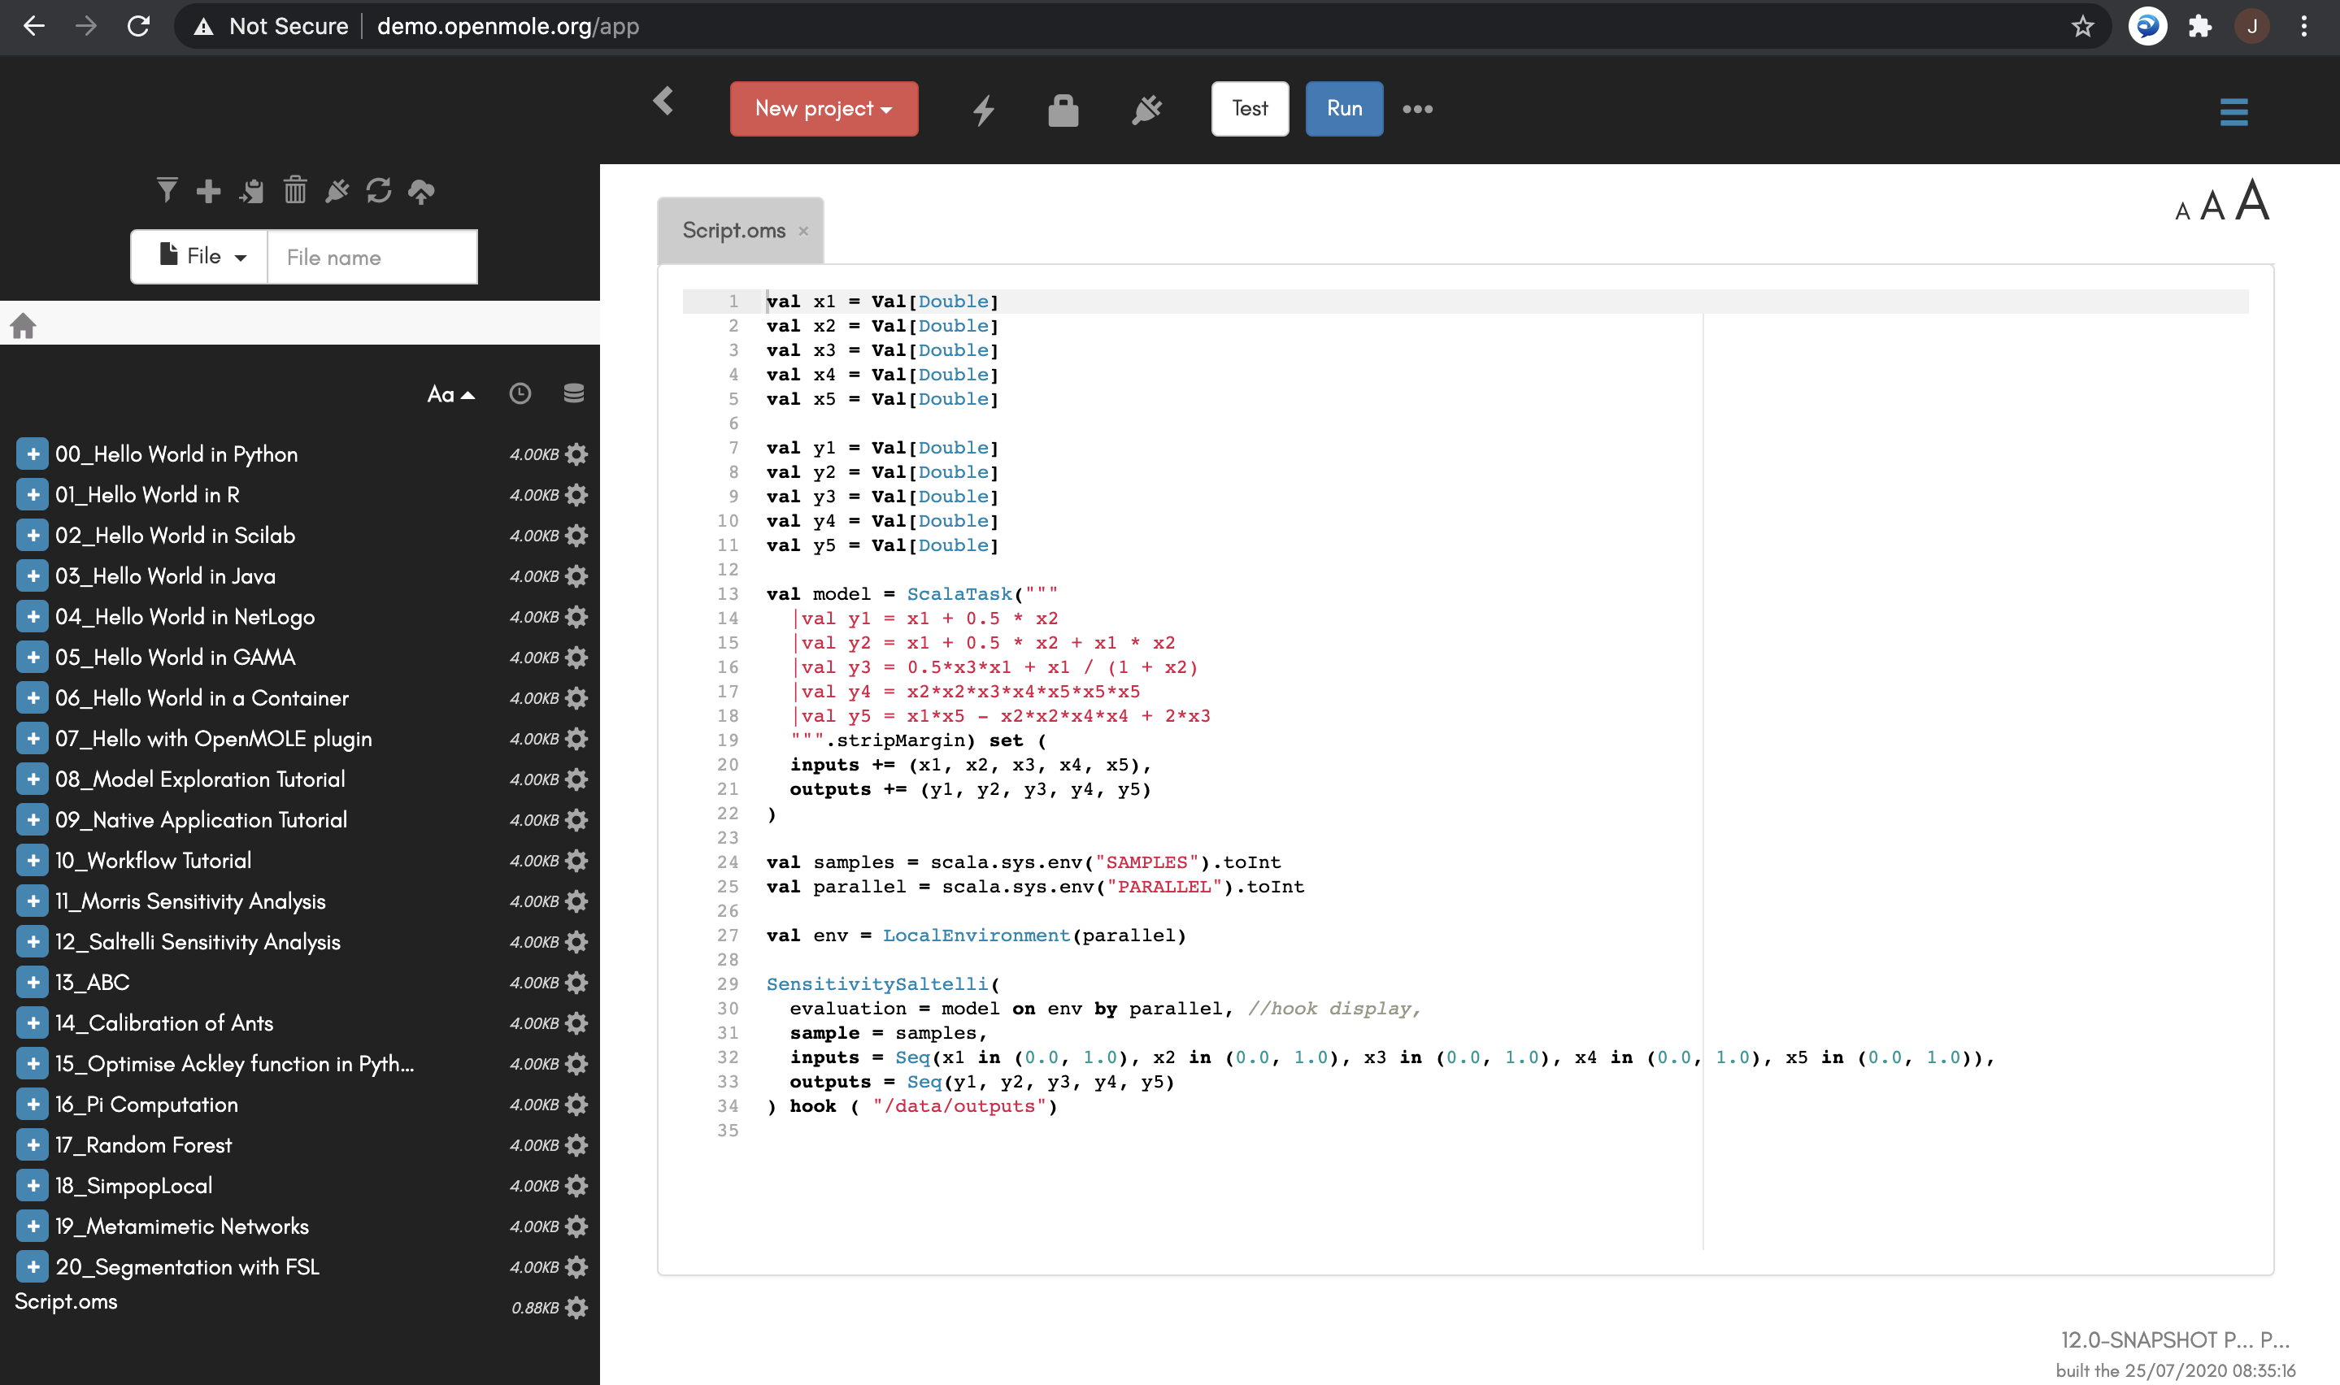
Script for model and global sensitivity analysis
Notes:
7

Slide 8
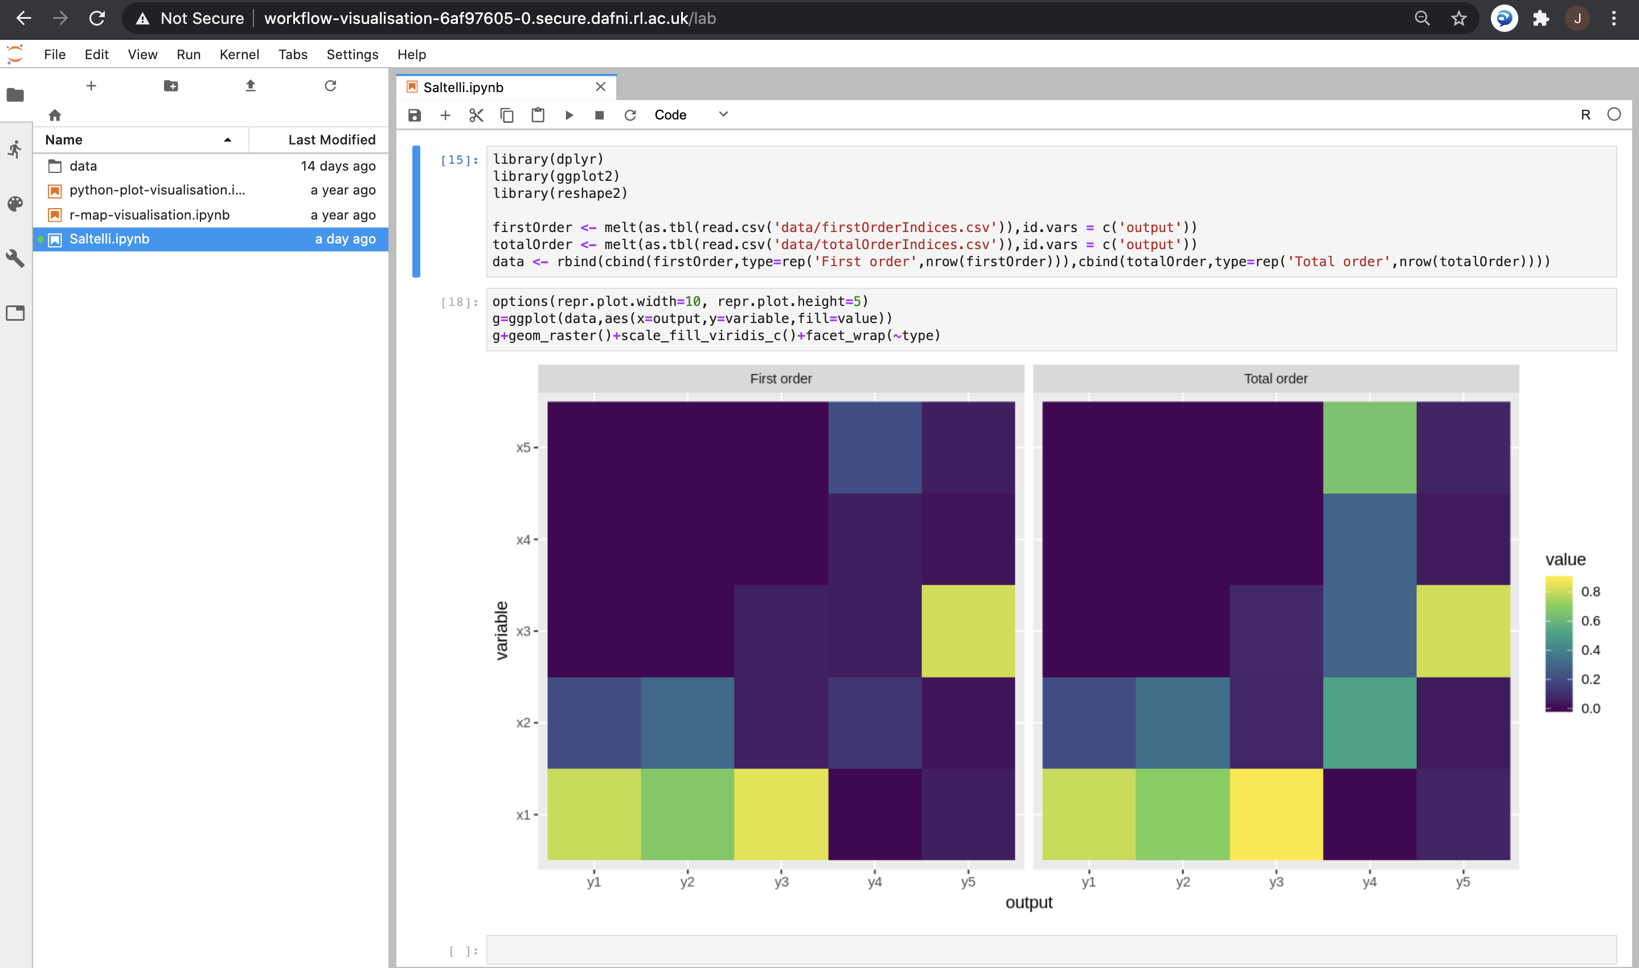
Visualisation of results
Notes:
8

Slide 9
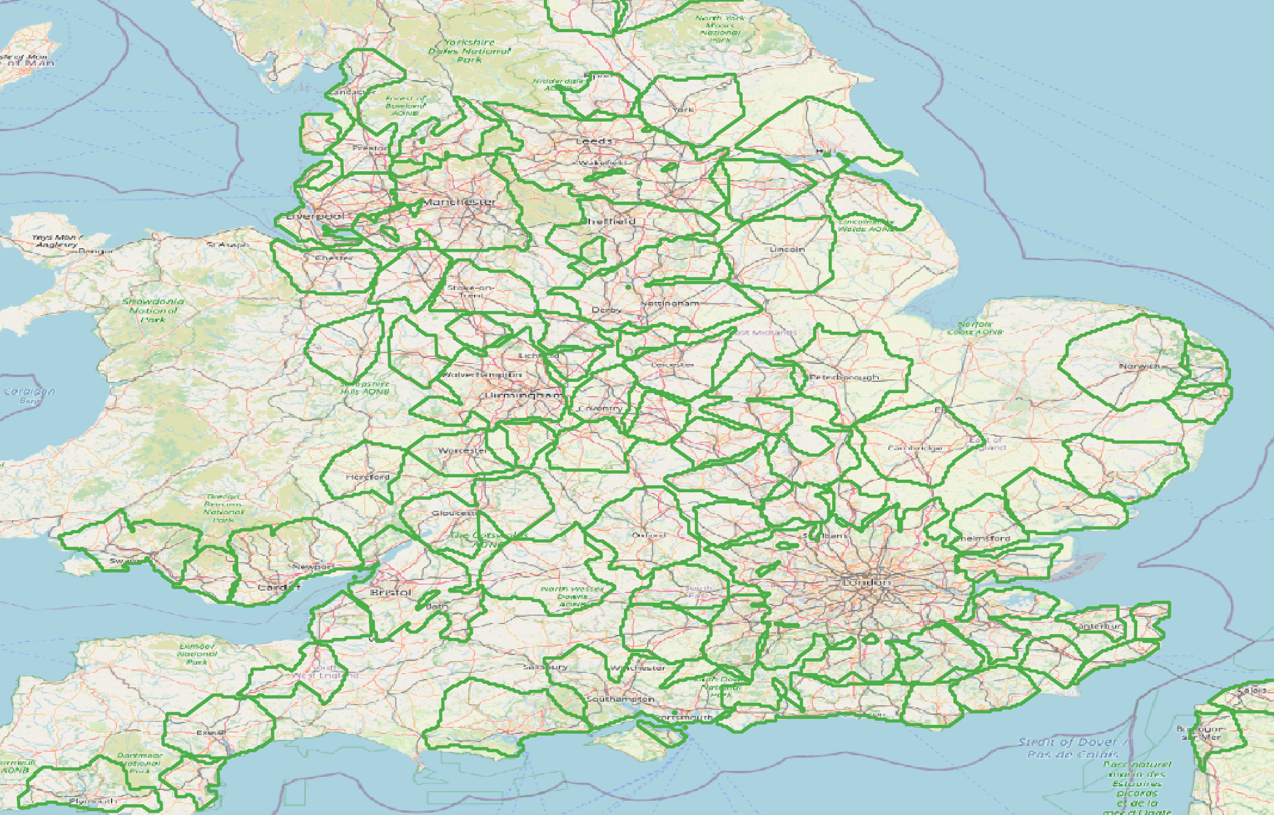
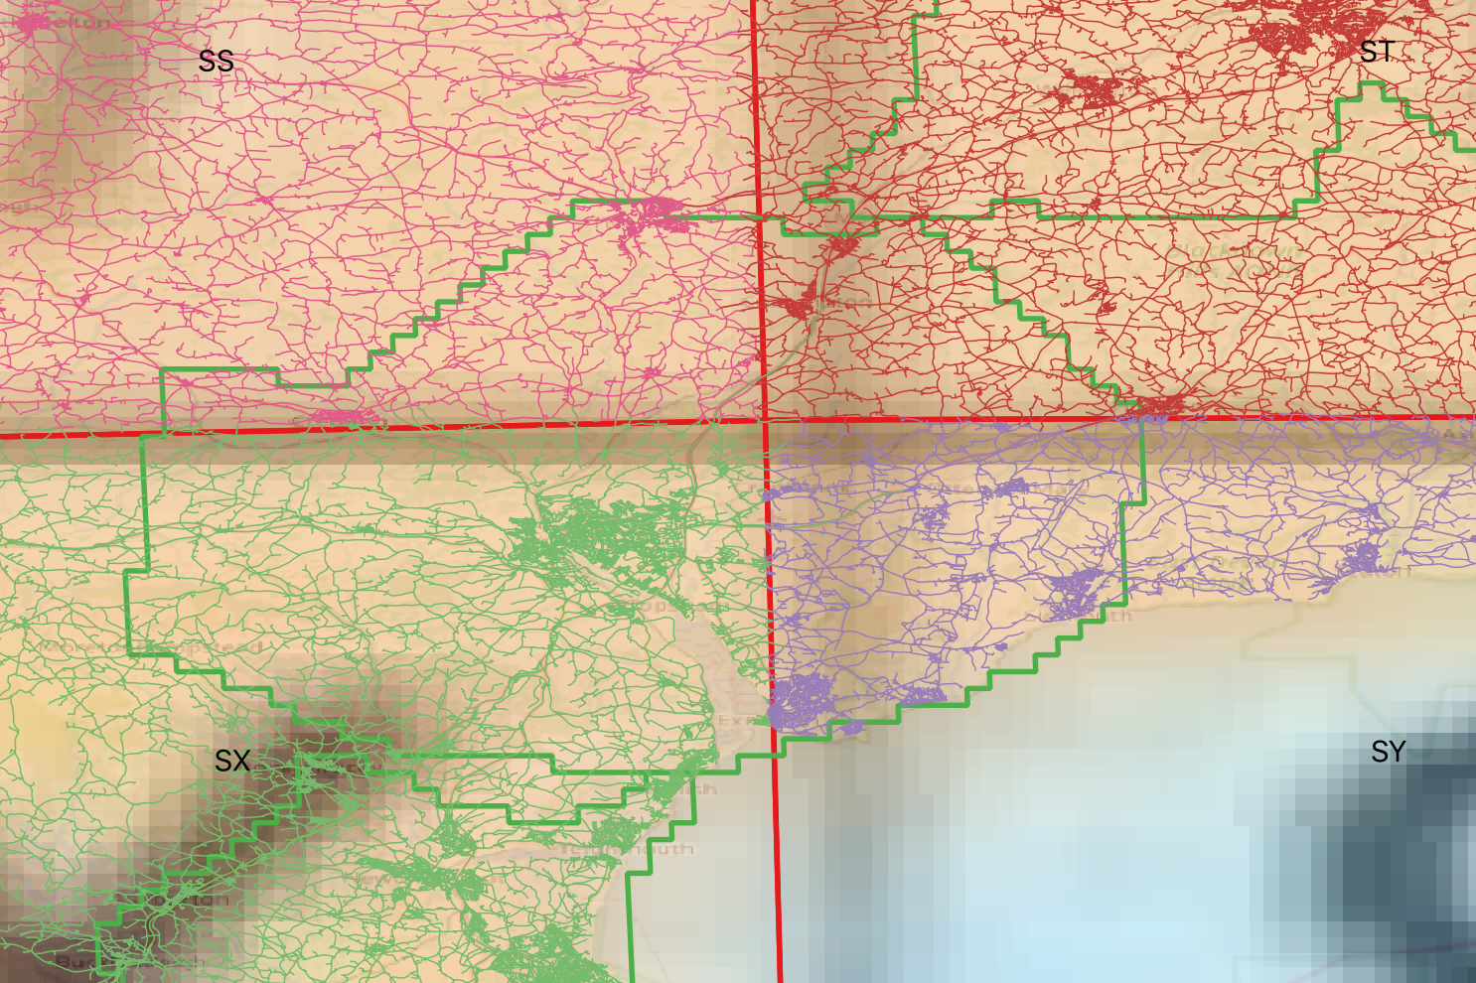
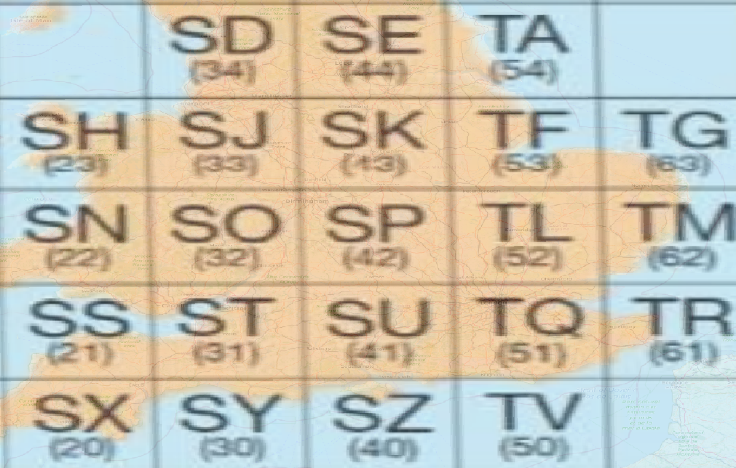
Road network preprocessing for MATSim on Functional Urban Areas
GHS FUAs
Construct topological network Export to MATSim xml
OS Roads tiles
Merge for queried FUA
Implemented in the spatialdata scala library, DAFNI embedding with a sbt docker
Notes:
9

Slide 10
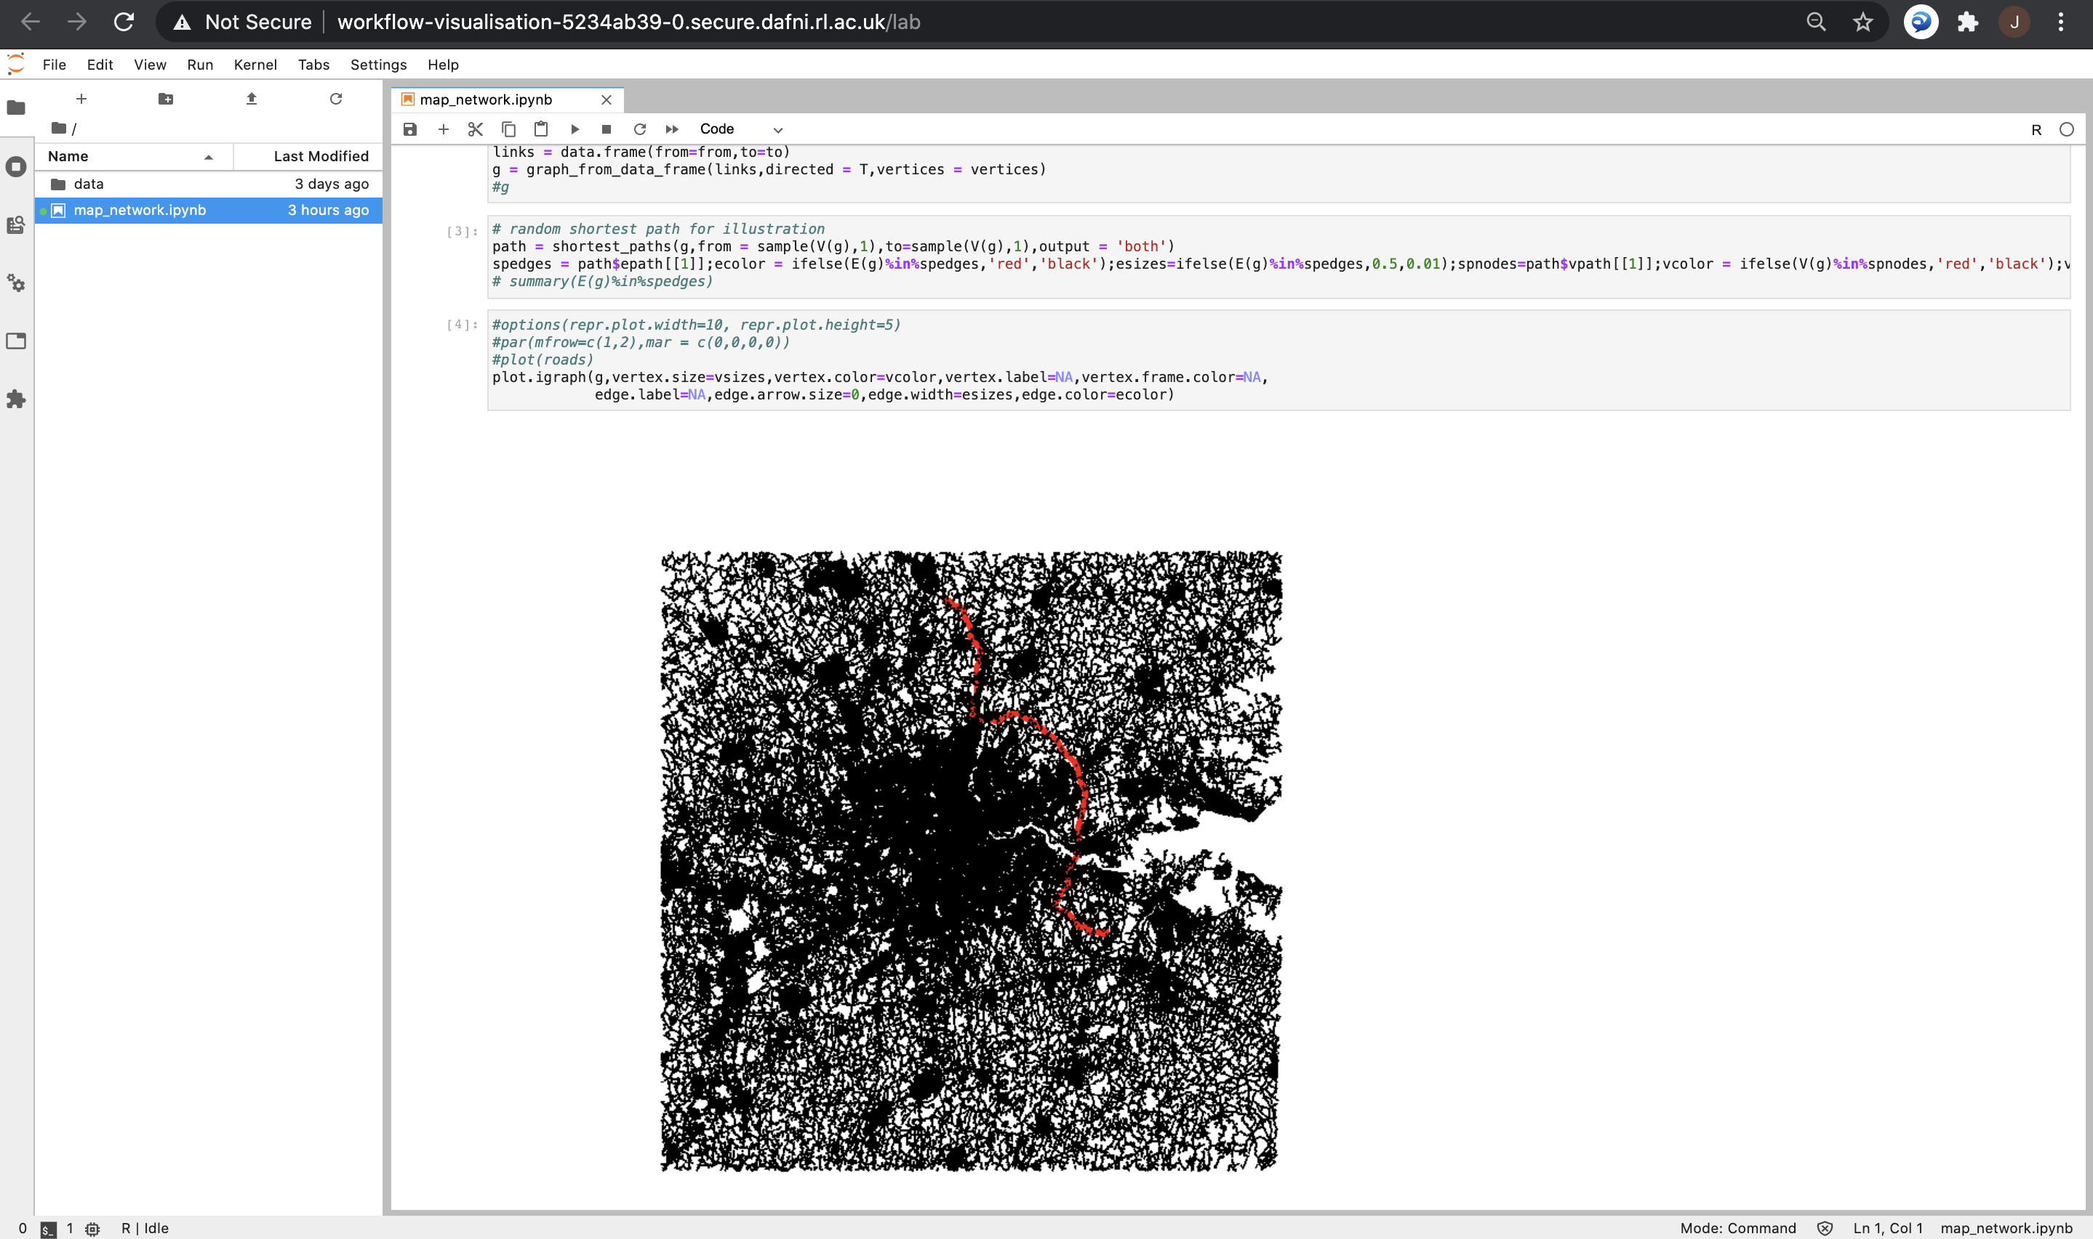
Visualisation of road network processing
Notes:
10

Slide 11
SPENSER model for synthetic population
Synthetic population generation (individuals or households) module of the SPENSER microsimulation framework developed by N. Lomaks at Leeds
Provided as a docker on dockerhub (version 1.4): running DAFNI workflow producing synthetic population csv files for given Local Authorities, at MSOA level and in time using population projections (2011-2050)
Next steps:
Implement some visualizations
Run different modules (only synthetic population for now)
Notes:
11

Slide 12
SPENSER synthetic population microscopic distribution
Synthetic individuals and households at the MSOA level in 2020 for all UK, integrated in the NID
Implemented in spatialdata: distribute uniformly within the MSOA on network nodes; attribute jobs randomly within the FUAs given the MSOA employment distribution; basic home-work plans with uniform start/end times
Future work: “Four stage model”
Distribute households within MSOAs according to population density grid (100m Eurostat or 1km GHSL) and buildings (OpenStreetMap; OSM pbf implemented in spatialdata) – individuals already matched in SPENSER data
Use QUANT calibrated parameters to estimate potential home-work flows
Sample workplace given these flows, accessibility patterns and car ownership
Notes:
12

Slide 13
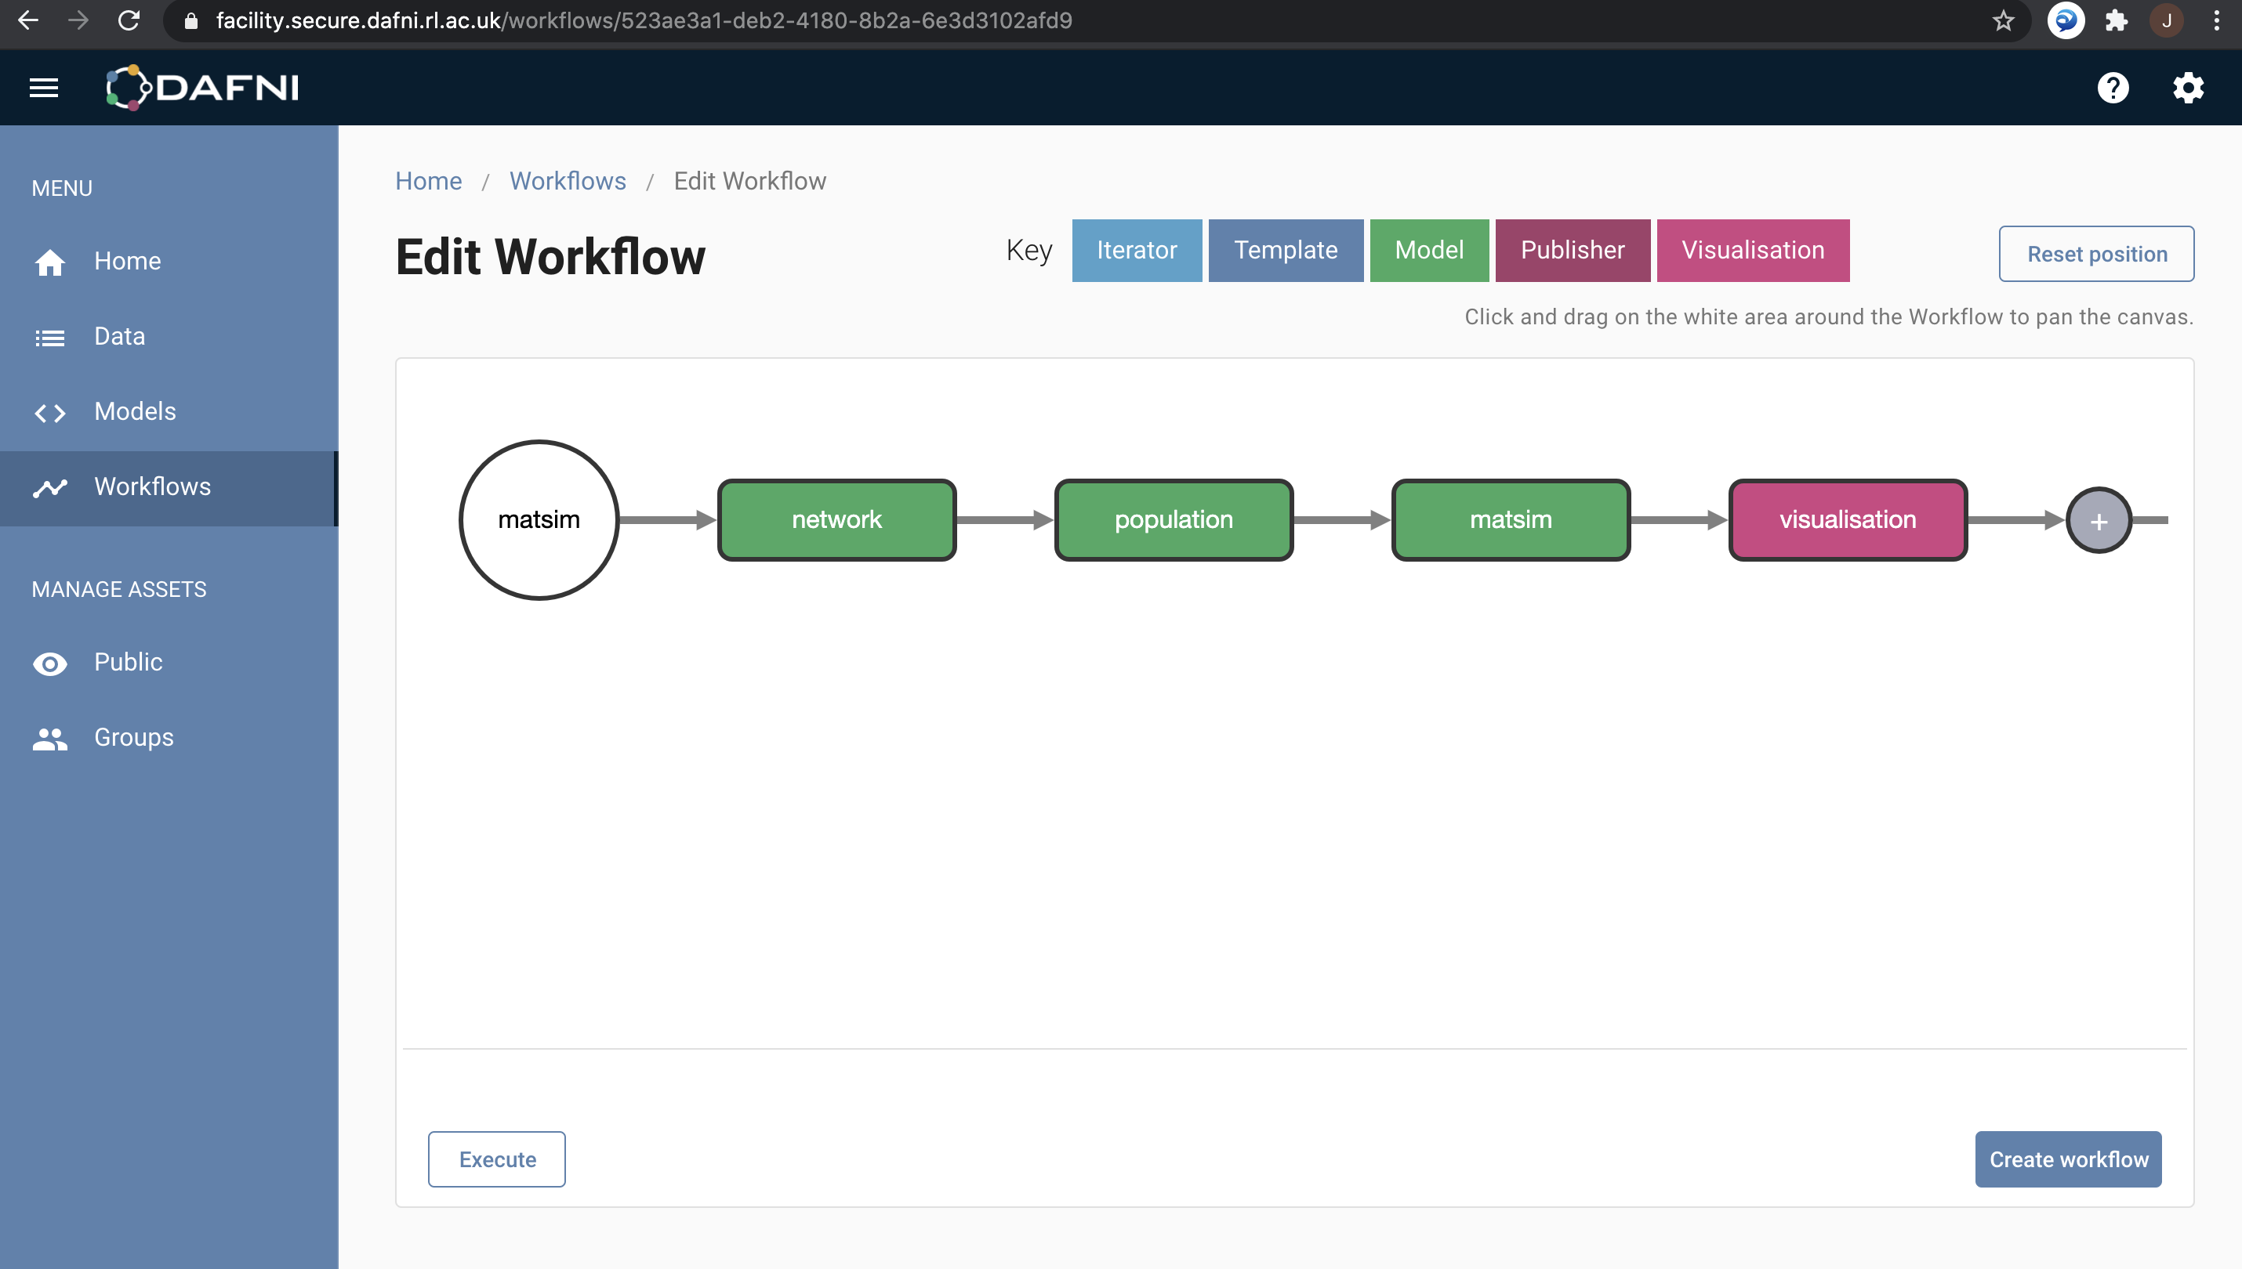
Full MATSim workflow on DAFNI
Notes:
13

